Slide 1
Project Title: Rapido Dead Mileage
Name: Rishav Kumar Singh
Date: 12-02-2006

Slide 2
Introduction
"Urban mobility is a puzzle of supply and demand. In this project, I have used SQL to build a data-driven solution for the common challenges in the ride-sharing industry. By analyzing a dataset of 100+ ride transactions and nearly 90 user profiles, this database is built to answer three key questions:
Revenue Loss: Why are rides being cancelled?
Loyalty: How do Gold and Platinum subscriptions affect booking frequency?
Geography: Which areas of Bengaluru are driving the highest demand? This database provides the structural foundation to turn these questions into answers."

Slide 3
Power BI
INTRODUCTION:-
The Objective: The goal of this Power BI project is to transform raw ride-sharing data into a strategic decision-making tool. By analyzing over 100 ride transactions and nearly 90 user profiles, this dashboard provides a real-time view of operational health, revenue trends, and customer behavior across Bengaluru’s key hubs.
Data Architecture & Connectivity. At the heart of this report is a robust relational model. I have established a direct link between the Rapido_User (Master Data) and Rapido_Captain (Transactional Data) tables. This connection allows us to bridge the gap between “who the customer is” and “how the service is performing,” ensuring every insight is backed by data integrity.
Core Analytical Pillars: The dashboard is structured into three essential views:
Executive Summary: Tracking high-level KPIs like total rides and the current average fare of ₹129.97.
Operational Health: Monitoring the “Leaking Bucket” of cancellations and identifying service gaps in vehicle types like Bikes, Autos, and Cabs.
Revenue & Geography: Visualizing financial spikes over time and mapping high-demand pickup areas such as Bellandur, HSR Layout, and Electronic City to optimize captain positioning.
Conclusion: This presentation moves beyond static charts to offer a dynamic look at urban mobility. By the end of this session, you will see how these visualizations provide the clarity needed to reduce cancellations, improve supply-demand balance, and maximize total revenue.

Slide 4
1. The "Ghost Demand" Analysis (Cancellation Patterns)
Business Problem: High cancellation rates frustrate users and reduce revenue.
We need to know why and where rides are failing.
Analysis: Compare the Status and Cancellation_Reasons across different Pickup_Areas.
Key Question: Are cancellations happening because Captains are "Late" (Supply issue) or because Users "Changed Mind" (UI/Pricing issue)?
Data Goal: Identify the top 3 "High-Churn" areas where Rapido should offer Captain incentives to reduce wait times.

Slide 5
SELECT TOP 3 Pickup_Area,[status],Cancellation_Reasons,
count(*) AS Total_Rides,
SUM(CASE WHEN [Status]='Cancelled' THEN 1 ELSE 0 END)AS Status,
(CAST(SUM(CASE WHEN status ='cancelled' THEN 1 ELSE 0 END) AS Float)/count(*))* 100 as cancellation_Rate
FROM Rapido_Captain AS RC
INNER JOIN
Rapido_User as RU
ON
RC.Rider_id = RU.Rider_id
--WHERE [Status] = 'Cancelled'
GROUP BY Pickup_Area,Cancellation_Reasons,[Status]
SELECT TOP 3 Pickup_Area,
COUNT(*) AS Total_Rides,
SUM(CASE WHEN Status = 'Cancelled' THEN 1 ELSE 0 END) AS Cancelled_Rides,
(CAST(SUM(CASE WHEN Status = 'Cancelled' THEN 1 ELSE 0 END) AS FLOAT) / COUNT(*)) * 100 AS Cancellation_Rate
FROM Rapido_Captian
GROUP BY Pickup_Area
ORDER BY Cancellation_Rate DESC;

Slide 6
OUTPUT
Pickup_Area | Total_Rides | Cancelled_Rides | Cancellation_Rate
Hebbal | 7 | 3 | 42.85714286
Electronic City | 8 | 2 | 25
Marathahalli | 8 | 2 | 25
Pickup_Area | status | Cancellation_Reasons | Total_Rides | Status | cancellation_Rate
Bellandur | Completed | None | 8 | 0 | 0
Bellandur | Cancelled | Wrong Location | 2 | 2 | 100
Electronic City | Cancelled | Captain Late | 1 | 1 | 100

Slide 7
2. Service Level Revenue Optimization
Business Problem: Rapido offers different service levels (Basic, Economic,Premium, Delivery).
We need to know which one is the "Cash Cow."
Analysis: Calculate the Revenue per KM for each Service_Level and Vehicle_Type.
Formula: SUM(Fare_INR) / SUM(Distance_km) grouped by Service_Level.
Key Question: Does "Auto Share" generate more revenue per kilometer than "Bike" despite lower fares?
Data Goal: Determine which service level should be promoted during peak hours to maximize profit.

Slide 8
SELECT DISTINCT(Vechile_Type),Service_level,--,Total_Rides_Booked,
SUM(Fare_INR) AS Renv,
CAST(SUM(fare_INR) / SUM(Distance_km)AS DECIMAL(10,1)) AS PER_KM_CHARGE,
count(Total_Rides_Booked ) AS Grand_Total_Rides
--(SELECT (Total_Rides_Booked))
--DENSE_RANK()OVER(ORDER BY Total_Rides_Booked DESC)
FROM Rapido_Captain AS RC
INNER JOIN
Rapido_User as RU
ON
RC.Rider_ID=RU.Rider_ID
WHERE Vechile_Type IN ('Auto share','Bike','parcel','cab','Auto')
AND Service_level IN('Basic','Delivery','Economic','premium')
AND Rider_Time BETWEEN '8:00:00' AND '11:00:00'
GROUP BY Vechile_Type,Service_level
ORDER BY Grand_Total_Rides DESC;

Slide 9
Vechile_Type | Service_level | Renv | PER_KM_CHARGE | Grand_Total_Rides
Auto Share | Economic | 365 | 11.9 | 5
Parcel | Delivery | 267 | 14.9 | 4
Bike | Basic | 248 | 18 | 3
Auto | Basic | 213 | 17.9 | 2
Cab | Economic | 378 | 30 | 2
Cab | Premium | 675 | 45 | 2

Slide 10
3. User Segmentation & Loyalty (RFM Analysis)
Business Problem: We want to know who our "Power Users" are so we can give them better subscription offers.
Analysis: Link Rapido_Userss and Rapido_Captianssee on Customer_ID.
Key Question: Do users with a Gold or Platinum subscription actually book more rides and have higher User_Rating_by_Captain?
Data Goal: Identify "Basic" users who have high Total_Rides_Booked but
haven't upgraded to a subscription yet. These are targets for a marketing campaign.

Slide 11
SELECT TOP 5 Total_Rides_Booked, [User_Name], Subscription_Type FROM Rapido_Captain AS RC
INNER JOIN
Rapido_User AS RU
ON
RC.Rider_id=Ru.Rider_id
WHERE Subscription_Type = ('Basic')
GROUP BY [User_Name],Total_Rides_Booked,Subscription_Type
HAVING Total_Rides_Booked >=26
ORDER BY Total_Rides_Booked DESC

Slide 12
Total_Rides_Booked | User_Name | Subscription_Type
44 | Sneha Nair | Basic
43 | Anita Gupta | Basic
41 | Sneha Sharma | Basic
39 | Anita Deshmukh | Basic
38 | Sneha Mehta | Basic

Slide 13
4. Peak Hour Supply-Demand Gap
Business Problem: During certain times, the Fare_INR might be high, but if the Status is mostly
"Cancelled," we are losing money.
Analysis: Group data by Rider_Time (Hour of the day) and Status.
Key Question: What are the "Golden Hours" (High completion + High Fare) vs. "Stress Hours" (High demand + High Cancellation)?
Data Goal: Recommend a "Surge Pricing" window or a "Captain Shift" shift change to ensure more bikes are
on the road during Stress Hours.

Slide 14
SELECT CAST(Rider_Time AS TIME(0)) AS Time,Fare_INR,[Status] FROM Rapido_Captain AS RS
INNER JOIN
Rapido_User AS RU
ON
RS.Rider_ID=RU.Rider_ID
WHERE [Status] IN ('Cancelled') AND Rider_Time BETWEEN '8:00:00' AND '10:30:00’
WITH Hourlyfair as(
SELECT DATEPART(HOUR,Rider_Time)AS HOURS,[Status],Vechile_Type, AVG(Fare_INR)AS fare_Inr,
DENSE_RANK() OVER (ORDER BY MAX(Fare_INR)DESC) AS Profit_Rank
FROM Rapido_Captain AS RC
INNER JOIN
Rapido_User AS RU
ON
RC.Rider_ID=RU.Rider_ID
WHERE [Status]='Completed'
GROUP BY DATEPART(HOUR,Rider_Time),Fare_INR,[Status],Vechile_Type
--ORDER BY Fare_INR DESC
)
SELECT * FROM Hourlyfair
WHERE Profit_Rank <=5

Slide 15
SELECT TOP 4 DATEPART(HOUR,Rider_Time)AS Time_In_Hours,COUNT (*) AS Cancelleation_Time,--,Pickup_Area,
CAST(COUNT(*) * 100.0/ (SELECT COUNT(*)FROM Rapido_Captain)AS decimal(10,2)) AS Percentage,
[Status]
--DENSE_RANK() (OVER (PARTITION BY Rider_Time) ) as HOURS
FROM Rapido_Captain AS RC
INNER JOIN
Rapido_User AS RU
ON
Rc.Rider_ID=Ru.Rider_ID
WHERE [Status]='Cancelled'
GROUP BY DATEPART(HOUR,Rider_Time),[Status]--,Pickup_Area
HAVING COUNT(*)<=5
ORDER BY Cancelleation_Time DESC

Slide 16
SELECT TOP 5 SUM(Fare_INR)AS Potential_loss,
DATEPART(HOUR,Rider_Time)AS Stress_Hours,
[Status] FROM Rapido_Captain as RC
INNER JOIN
Rapido_User as Ru
ON
RC.Rider_ID=Ru.Rider_ID
WHERE [Status]='Cancelled'
GROUP BY DATEPART(HOUR,Rider_Time),[Status]
ORDER BY Potential_loss DESC

Slide 17
Golden Hours:-
HOURS | Status | Vechile_Type | fare_Inr | Profit_Rank
9 | Completed | Cab | 522 | 1
21 | Completed | Cab | 409 | 2
17 | Completed | Cab | 354 | 3
18 | Completed | Cab | 354 | 3
14 | Completed | Cab | 321 | 4
9 | Completed | Cab | 282 | 5

Slide 18
Stress Hours:-
HOURS | Status | Vechile_Type | fare_Inr | Profit_Rank
9 | Completed | Cab | 522 | 1
21 | Completed | Cab | 409 | 2
17 | Completed | Cab | 354 | 3
18 | Completed | Cab | 354 | 3
14 | Completed | Cab | 321 | 4
9 | Completed | Cab | 282 | 5

Slide 19
Performance Gap:-
Potential_loss | Stress_Hours | Status
920 | 20 | Cancelled
517 | 14 | Cancelled
327 | 12 | Cancelled
271 | 13 | Cancelled
212 | 7 | Cancelled

Slide 20
5. Area Profitability & Expansion
Business Problem: Rapido wants to know if they should expand their fleet in Electronic City or Indiranagar.
Analysis: Compare Pickup_Area vs Drop_Area.
Key Question: Which areas act as "Sinks" (many drops, few pickups) and which are "Sources" (many pickups, few drops)?
Data Goal: If a Captain drops a passenger in Hebbal but has to drive back empty to MG Road to get
a new ride, that's "Dead Mileage." Identify areas with the best "Back-to-Back" ride potential.*/

Slide 21
Data Goal:-
Area | Total_Pickup | Total_Drop | Efficiency_Ratio | Dead_milage_Volume
Bellandur | 10 | 6 | 1.67 | 4
MG Road | 10 | 7 | 1.43 | 3
Whitefield | 15 | 11 | 1.36 | 4
Koramangala | 13 | 11 | 1.18 | 2
HSR Layout | 12 | 11 | 1.09 | 1
Indiranagar | 10 | 11 | 0.91 | 1
Electronic City | 8 | 9 | 0.89 | 1
Marathahalli | 8 | 10 | 0.8 | 2
Jayanagar | 7 | 11 | 0.64 | 4
Hebbal | 7 | 13 | 0.54 | 6

Slide 22
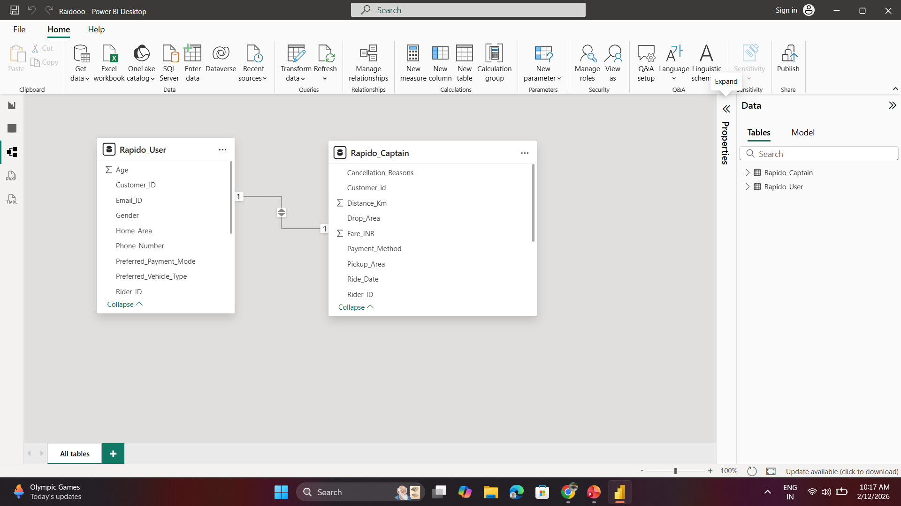

Slide 23
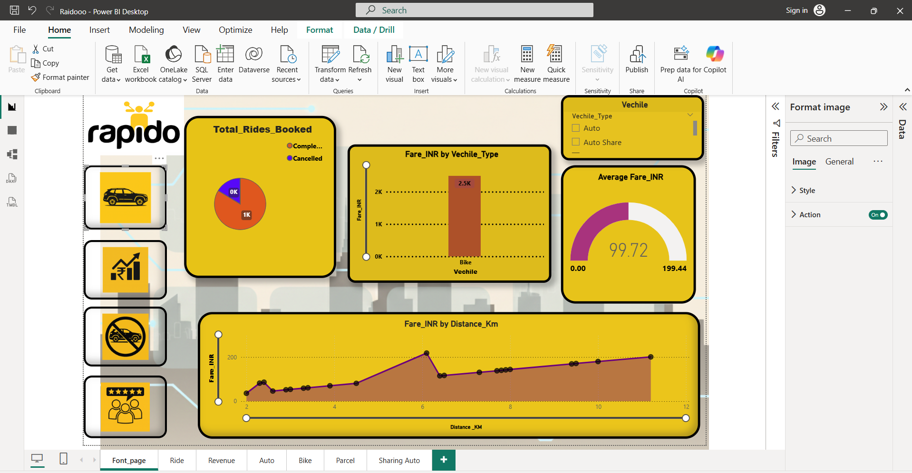

Slide 24
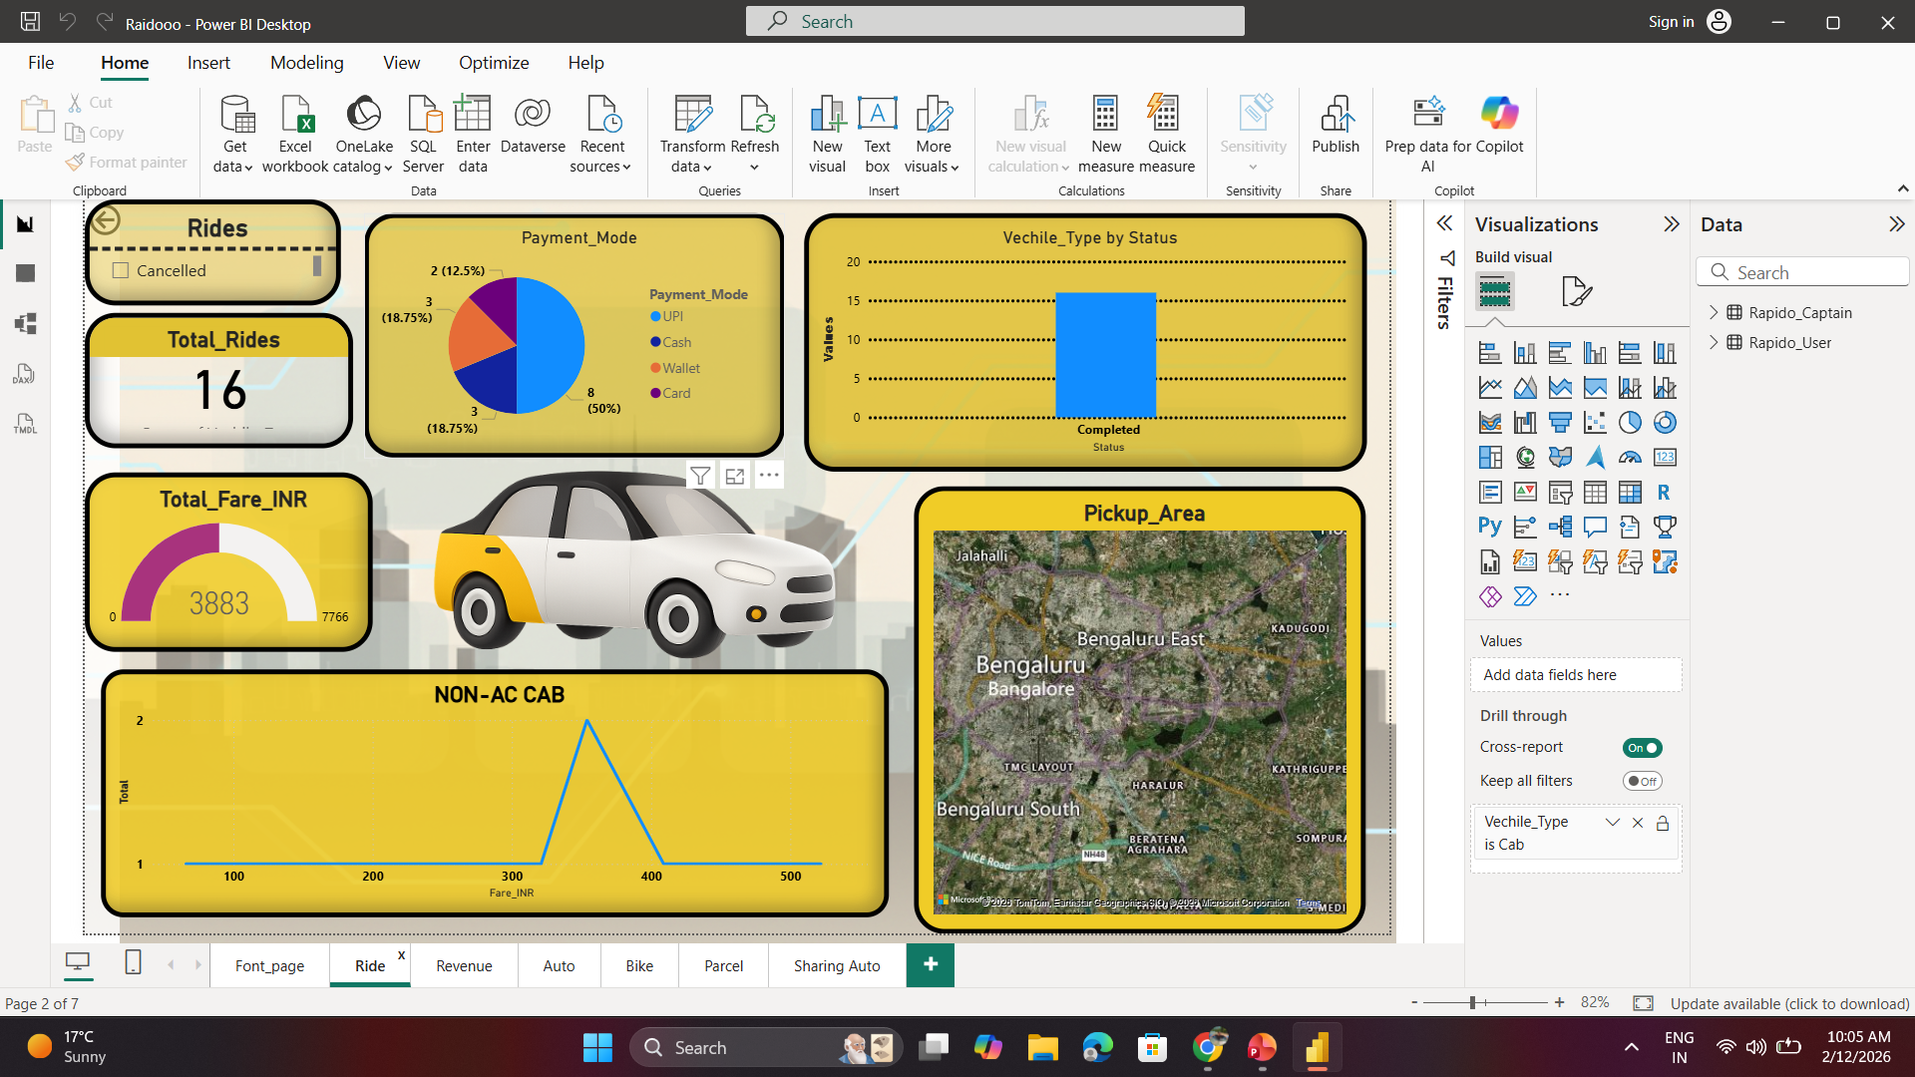

Slide 25
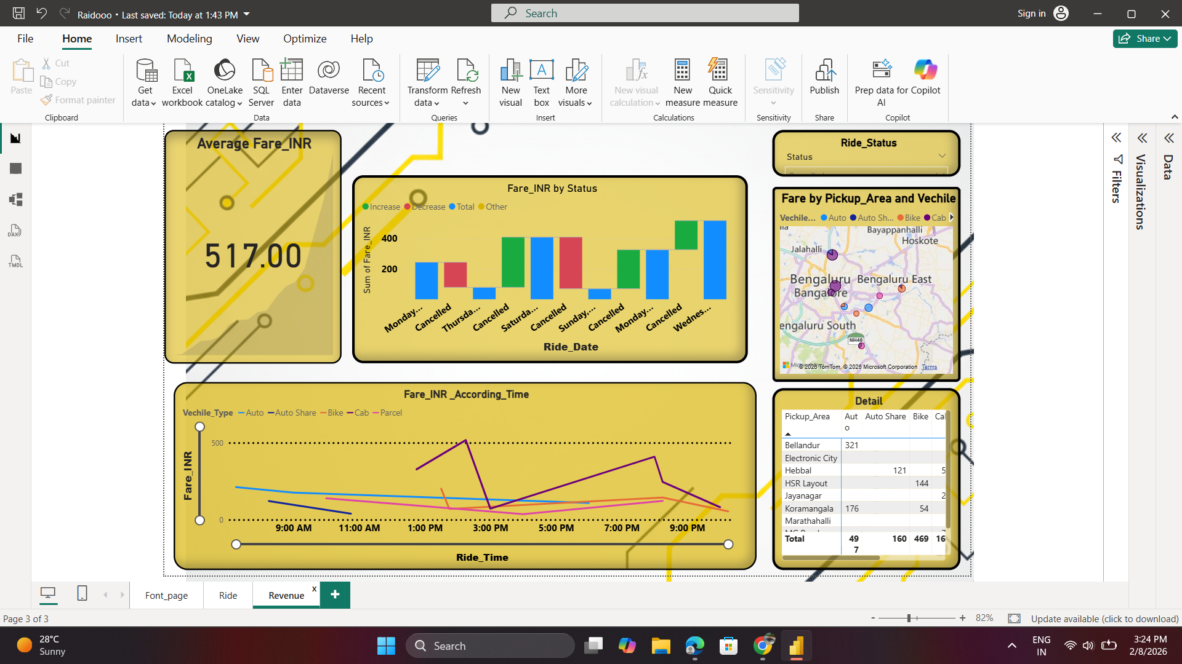

Slide 26
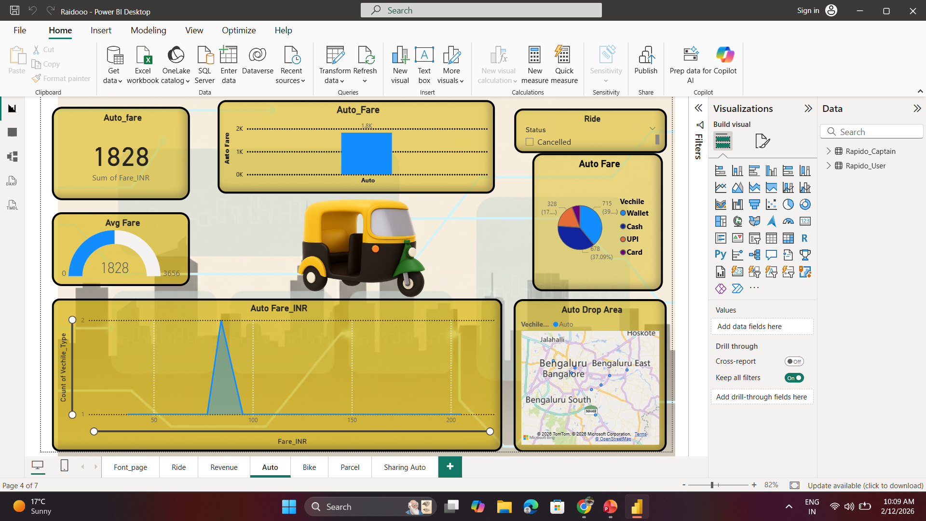

Slide 27
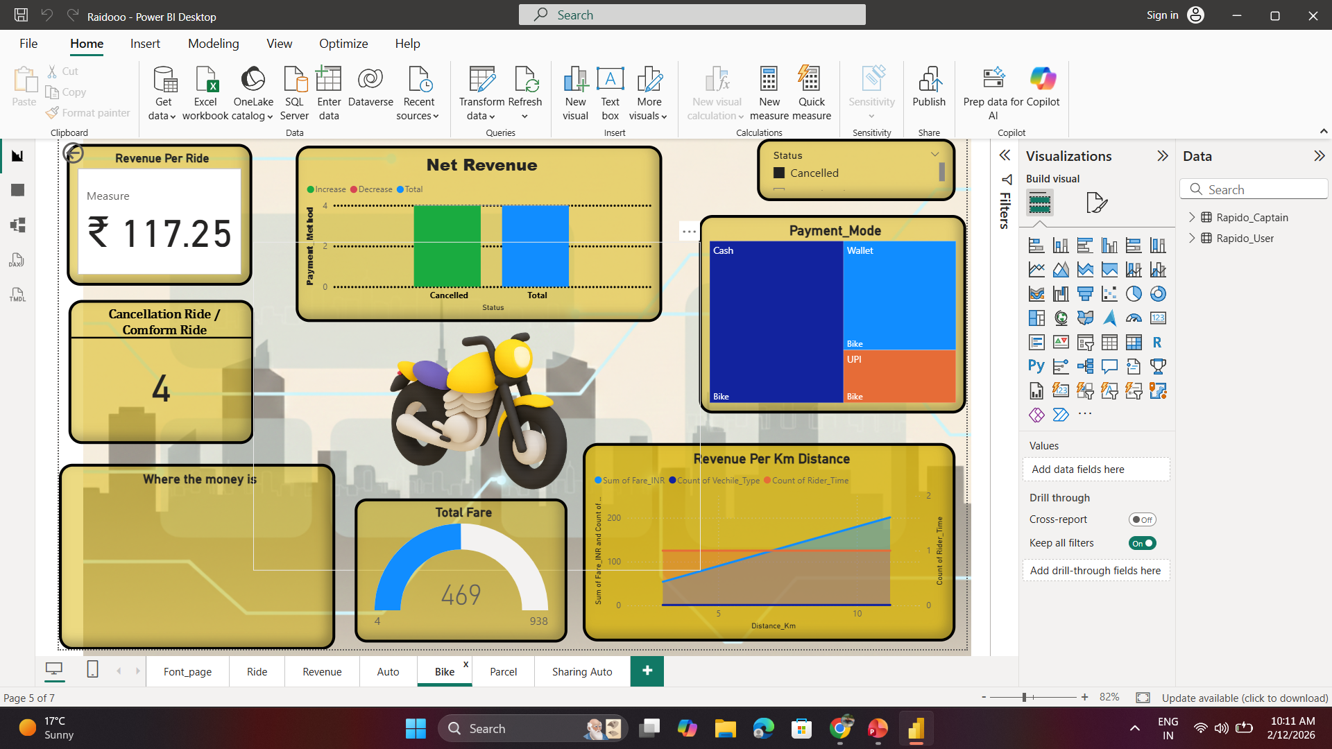

Slide 28
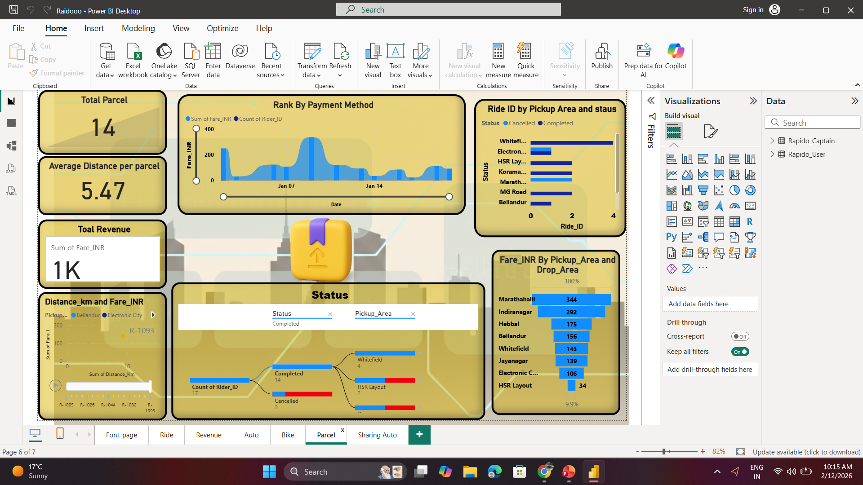

Slide 30
THANK YOU!

